Slide 1




Multi-Agent Knowledge Sharing System for News BiasDetection/Analyzer and Fact -Checking
Mid-Term Presentation - Group 6
3 Contributors

Slide 2
Introduction
In the digital age, the rapid spread of misinformation challenges traditional fact-checking methods. Multi-agent systems (MAS) with knowledge-sharing mechanisms enable collaborative intelligence to efficiently assess news credibility. By harnessing Artifical intellegent, Natural language processing and distributed models, MAS significantly improves the accuracy, scalability, and speed of news verification.

Slide 3
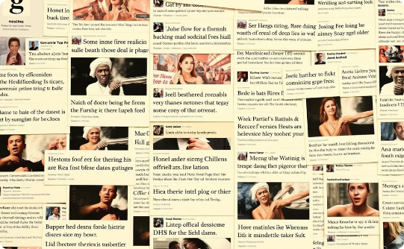

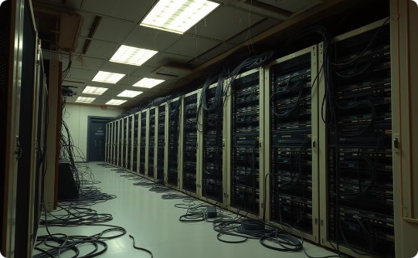
Problem Statement
Misinformation Spread
Inefficient Fact-Checking
Isolated Verification Models
False information spreads rapidly, posing risks to society.
Manual verification is slow and can't keep up at large scales.
Current models lack dynamic insight sharing.
A Multi-Agent System with Knowledge Sharing for News Evaluation will enable real-time collaboration among intelligent agents, facilitating automated credibility assessment and reducing the impact of misinformation.

Slide 4




Approach
Role-Specific Agents
Knowledge Sharing
Collaborative Reasoning
Tool Utilization
Agents specialize in fact-checking content Bias analysis, and context evaluation for efficient assessment.
Agents share insights update and retrieve information from Knowledge graph to improve decision-making and reduce redundancy.
Agents use external tools for news collection using newa api and store databases to verify facts and perform in-depth analyses.
Agents use discussions and consensus to evaluate news from multiple perspectives.

Slide 5
System Architecture

Slide 6
User Interface Layer
Streamlit-based chatbot interface for real-time article display, interactive query processing, and entity visualization.

Slide 7
Agent Layer
Specialized agents for various tasks, including inter-agent communication, state management, and error handling.

Slide 8
Knowledge Graph Layer
Neo4j database for entity relationships, temporal data, and source tracking, ensuring data integrity and efficient retrieval.

Slide 9
Analysis Layer
AWS Bedrock integration for bias detection, and fact verification, provides comprehensive news analysis.

Slide 10
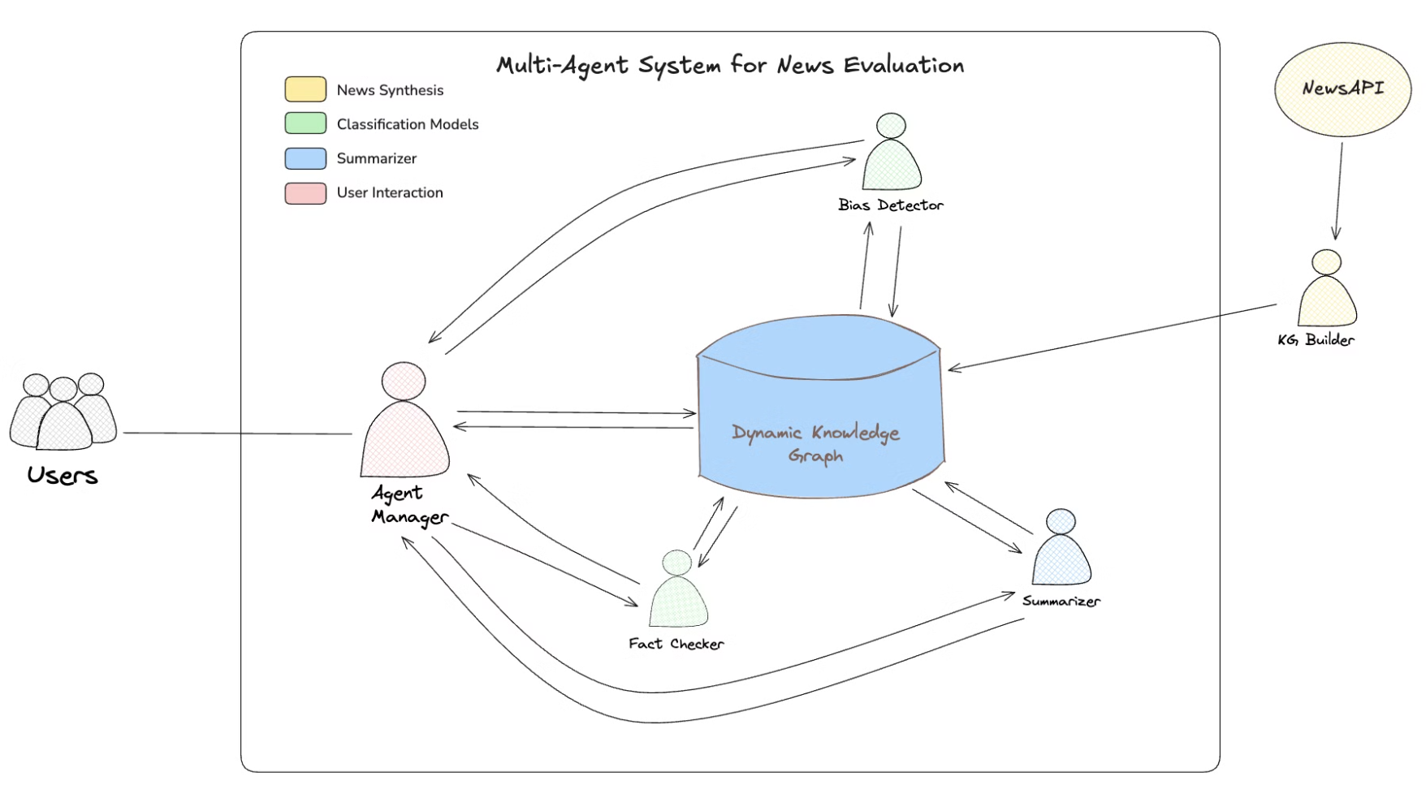

Slide 11
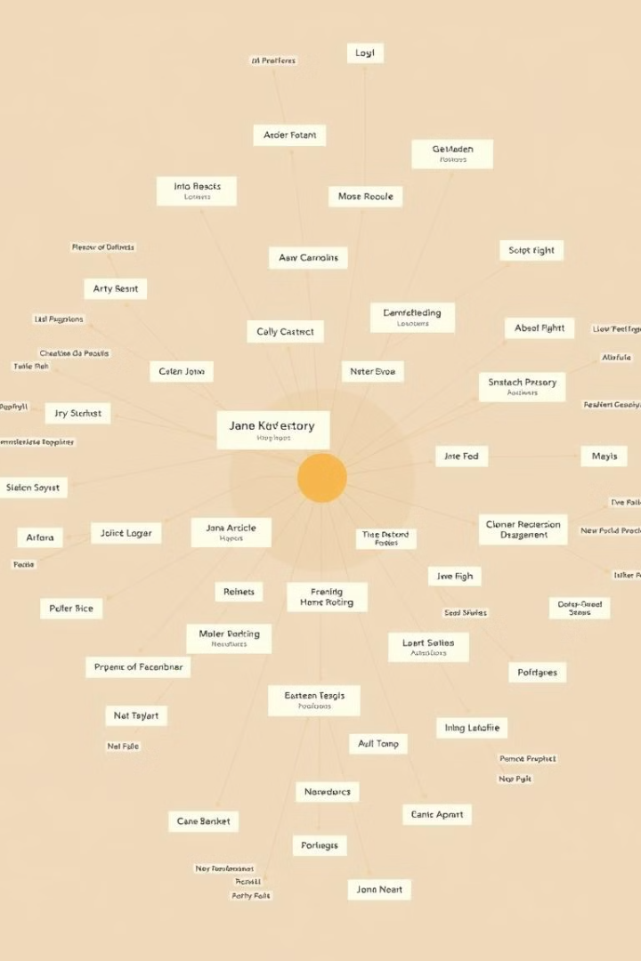




Knowledge Graph Components
Article Nodes
Entity Nodes
Title, content, date, source, bias score
1
2
Name, type, description, credibility
Relationships
Source Nodes
Connections between components
4
3
Name, type, credibility, bias rating
Key elements of the Knowledge Graph: Article Nodes, Entity Nodes, Source Nodes, and Relationships.

Slide 12




Technical Components
Python
AWS Bedrock
Core language for agent implementation.
Provides scalability and reliability for cloud deployment.
Neo4j
LangChain/LangGraph
Manages the knowledge graph with efficient data relationships.
Facilitates analysis chains for complex data processing.

Slide 13
Premilary Stage Evaluation-Benchmark
Independent testing of Bias-Detection/analyzer and fact-checking Using AWS Bedrock LLM
Notes:
chris's work

Slide 14
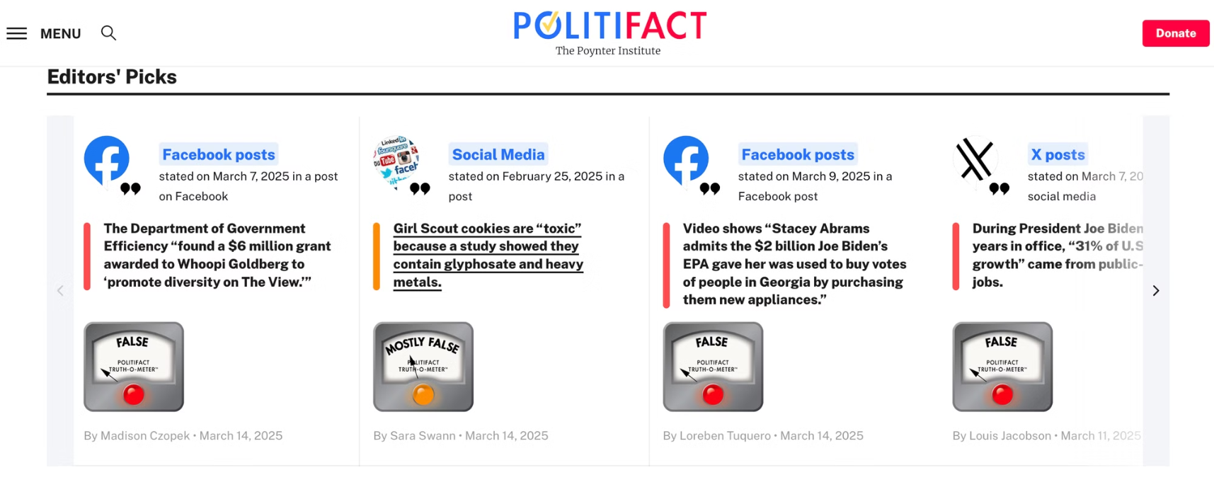
Datasets for Fact Checking BenchMark

Slide 15
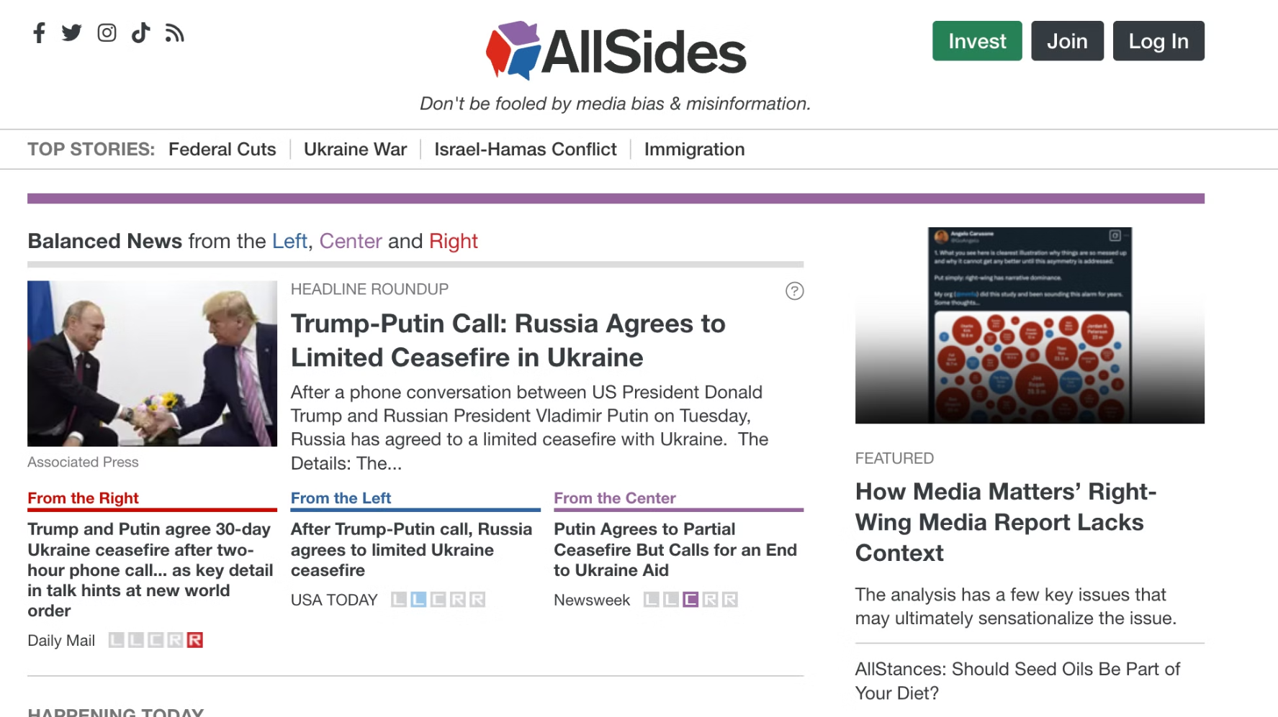
Dataset for Bias Detection Benchmark

Slide 16
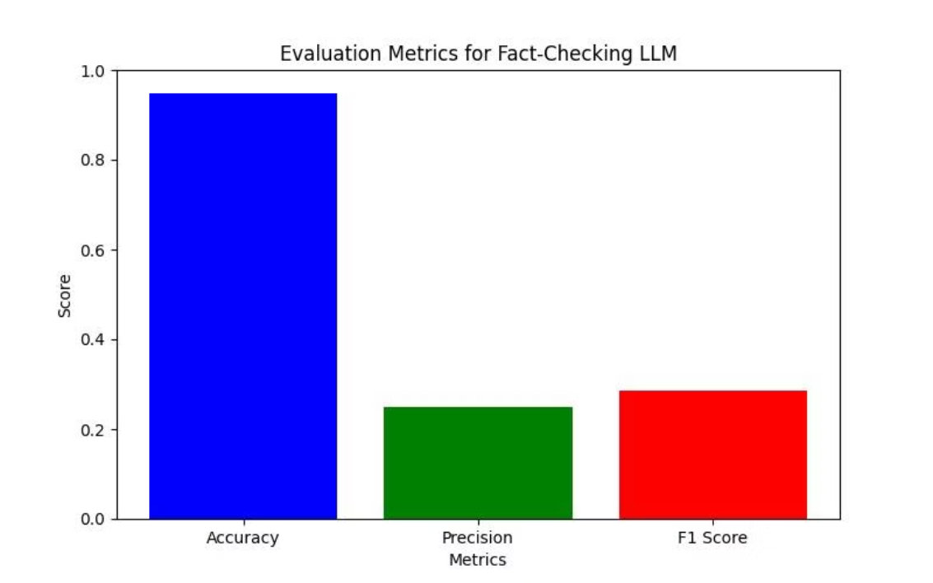
Fact-Checking Benchmark Results
Notes on Factcheck Benchmark:
Test data set based off of Politifact fact-checking.
Current dataset highly unbalanced.
Continuous collection of current news fact check to build a more balanced dataset.

Slide 17
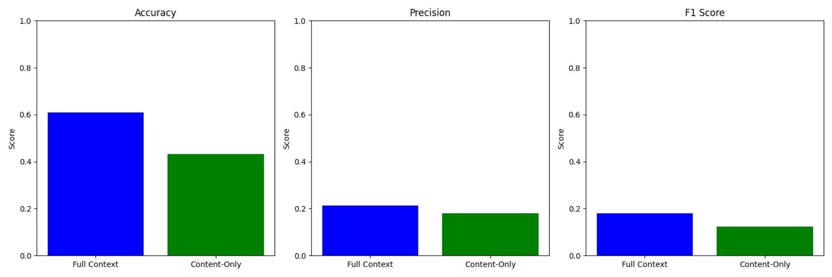
Bias Detection Benchmark Results
Benchmarked using All Sides Media Bias dataset using "Left", "Center", and "Right" bias.

Slide 18



Second Stage: System Testing & Enhancement
Unit Testing with Knowledge Graph
System Optimization
Overall System Testing and Evaluation
Tune performance, optimize resources, improve scalability, and enhance monitoring.
Perform unit tests for the overall system with the knowledge graph. Create advanced visualizations.
Evaluate fact-checking agent performance using the PolitiFact dataset.
Evaluate bias detection workflow separately.
Document the results of both evaluations and compare/analyze.

Slide 19
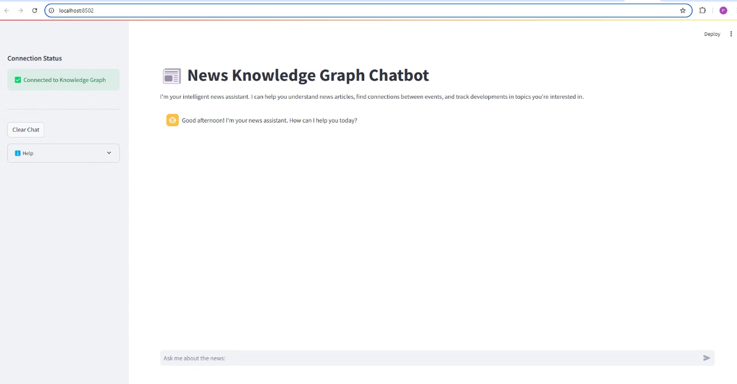
User interface of chatbot

Slide 20
Thank you

